Slide 1
Switching Characteristic of Transistors
Muhaimin Bin Munir

Slide 2
Transistor
A transistor is a device that regulates current or voltage flow and acts as a switch or gate for electronic signals. Transistors consist of three layers of a semiconductor material, each capable of carrying a current.
Application
Digital Switches
Signal Amplification
Device Controller
Logic Operations

Slide 3
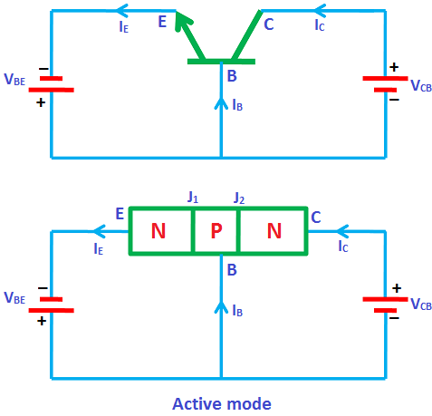
Operating Modes of Transistor
Active Mode
In this mode transistor is used as a current amplifier. In active mode, two junctions are differently biased that means emitter-base junction is forward biased whereas collector-base junction is reverse biased. In this mode current flows between emitter and collector and amount of current flow is proportional to the base current (I_{B}).

Slide 4
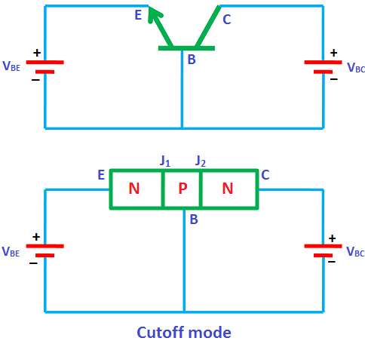
Operating Modes of Transistor
Cutoff Mode
In this mode, both collector base junction and emitter base junction are reverse biased. This in turn not allows the current to flow from collector to emitter when the base-emitter voltage is low. In this mode device is completely switched off as the result the current flowing through the device is zero.

Slide 5
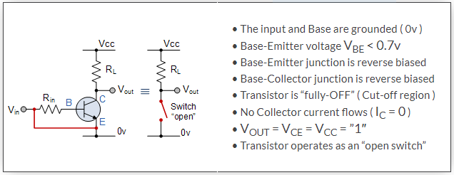
Cutoff Mode

Slide 6
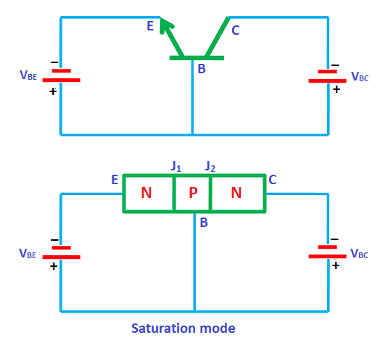
Operating Modes of Transistor
Saturation Mode
In this mode of operation, both the emitter base and collector base junctions are forward biased. Current flows freely from collector to emitter when the base-emitter voltage is high. In this mode device is fully switched ON.

Slide 7
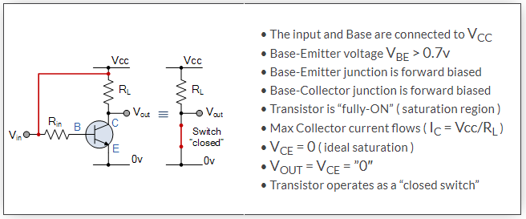
Saturation Mode

Slide 8
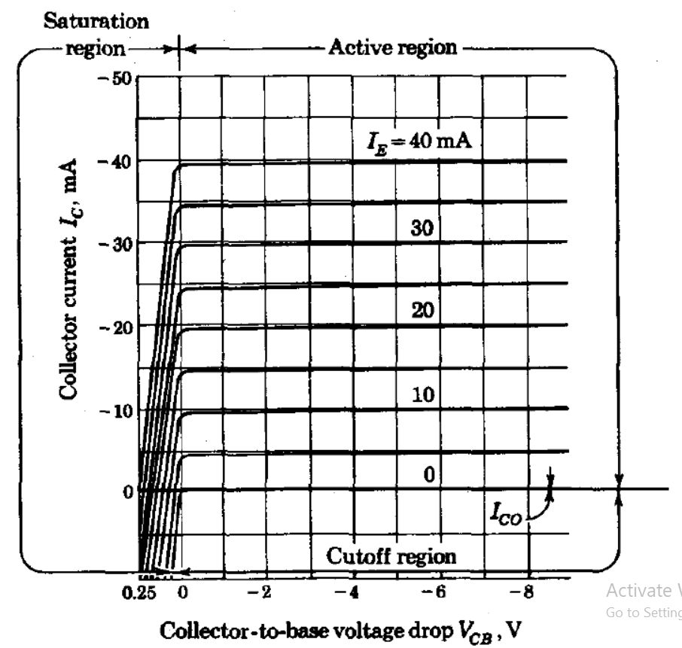
Characteristic of a BJT
The figure shows the output characteristics of a BJT Transistor. Here cutoff region has the operating conditions as zero collector output current, zero base input current and maximum collector voltage. These parameters causes a large depletion layer which further doesn’t allow current to flow through the transistor. Therefore, the transistor is OFF. Similarly, in the saturation region, a transistor is biased in such a way that maximum base current is applied that results maximum collector current and minimum collector-emitter voltage. This causes the depletion layer to become small and to allow maximum current flow through the transistor. Therefore, the transistor is ON.

Slide 9
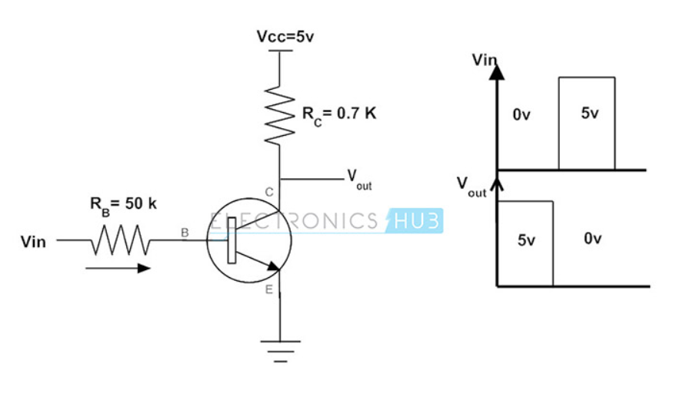
Example
Base Resistance, RB = 50k ohm
Collector Resistance, RC = 0.7k ohm Vcc = 5V
β = 125
V_{in} = 0V to 5V
What is the output at the collector by varying the Vin at two states that is 0 and 5V as shown in figure?

Slide 10
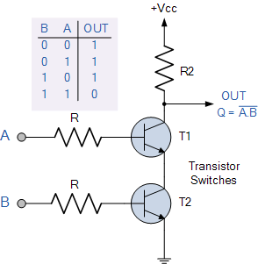
Transistor as NAND Gate

Slide 11
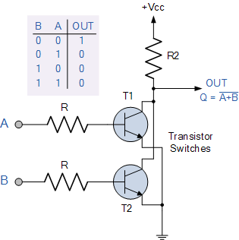
Transistor as NOR Gate

Slide 12
“And medecine, law, business, engineering, these are noble pursuits and necessary to sustain life. But poetry, beauty, romance, love: these are what we stay alive for.”
Dead Poets Society

